Slide 1
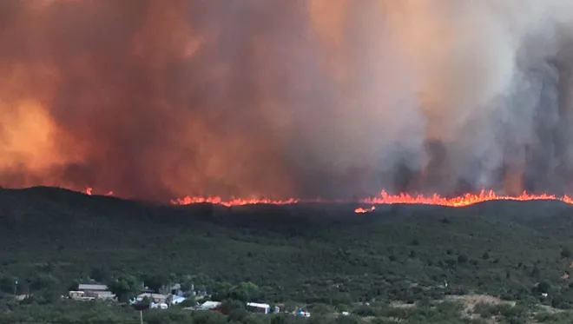
Arizona Property Wildfire Underwriting 101
Michelle Swavely
Personal Lines Account Executive
Crest Insurance Group

Slide 2
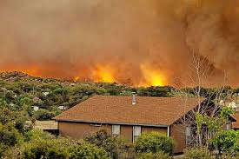
What does an Insurance Carrier’s Underwriting Department do?
The principles and practices of setting policy rates
The acceptance or rejection of risks
Understanding the total amount of risk acceptance for their company
The amount of retention for the insurers own account (policy deductible)
Treatment of the balance of risk with reinsurance
** Reinsurance is a third-party recompense that protects insurance companies from high claims with the intent to stabilize the insurance market and keep coverage available and affordable. Think of it as insurance for insurance companies.

Slide 3
What does an Insurance Carrier’s Underwriting team take into consideration when rating for wildfire?
Seeking a large volume of policies well disbursed in a defined territory based on the risk tolerance for the area.
How big is the individual risk for the location when all coverages of the policy are added together?
Dwelling + Other Structures + Personal Property + Loss of Use + Scheduled Property = ?
Construction details (i.e., age, exterior wall material, roof material, property condition…)
Occupancy (i.e., Homeowner, Secondary Home, Rental Property, Vacation Rental…)
Public Protection Class (PPC)/Fire District – Who is responding to a fire? What equipment do they have? What training and certifications do the crews have? Tax-based or Subscription-based? Driving distance to Responding Fire Station?
Water supply type? Hydrant with rating or hauled water?
Fire Mitigation Appliances (i.e., Alarms, Sprinklers, Fire Extinguishers…)
Degree of hazard from neighboring properties?
3

Slide 4
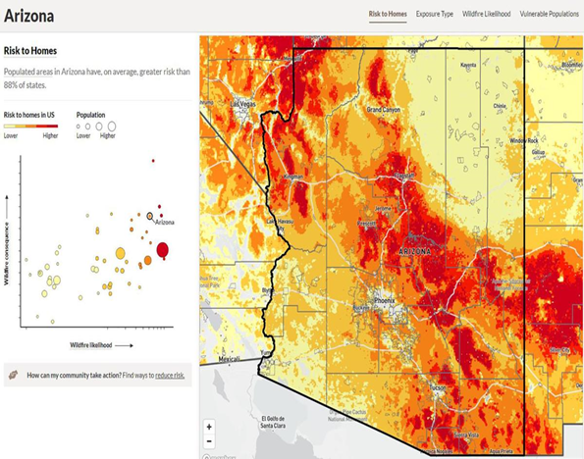
Where are the Insurance Carrier’s Underwriting Departments finding information regarding a specific wildfire risk outside of these factors?
Most use a combination of satellite images, census data, historic fire information or climate projection that can roughly determine a home's probability to burn — not only today, but over the next 30 years.
Some use proprietary programs while others use the Insurance Service Office (ISO) FireLine, and third-party programs (i.e., CoreLogic, Verisk…).
The scores range broadly from company to company.
4

Slide 5
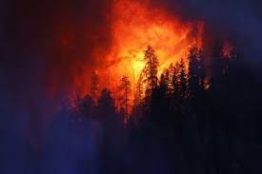
Thank you – open for questions

