Slide 1
Community Climate Profile for the Quad Cities Region of Arizona Draft Report Summary
Alison Meadow
Climate Assessment for the Southwest
University of Arizona
December 1, 2022

Slide 2
The CLIMAS team and our partners work to improve the ability of the region’s social and ecological systems to respond to and thrive in a variable and changing climate.
The program promotes collaborative research involving scientists, decision makers, resource managers and users, educators, and others who need more and better information about climate and its impacts.
Established in 1998
Funded through National Oceanic and Atmospheric Administration’s (NOAA) Climate Adaptation Partnerships program.
https://climas.arizona.edu/
Notes:
CLIMAS is a group of researchers based at University of Arizona and New Mexico State University.
One of 10 RISAs around the country

Slide 3
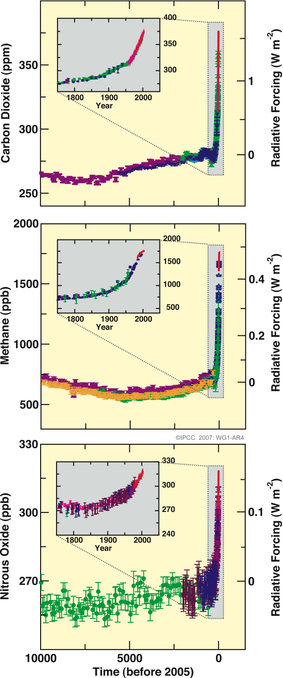
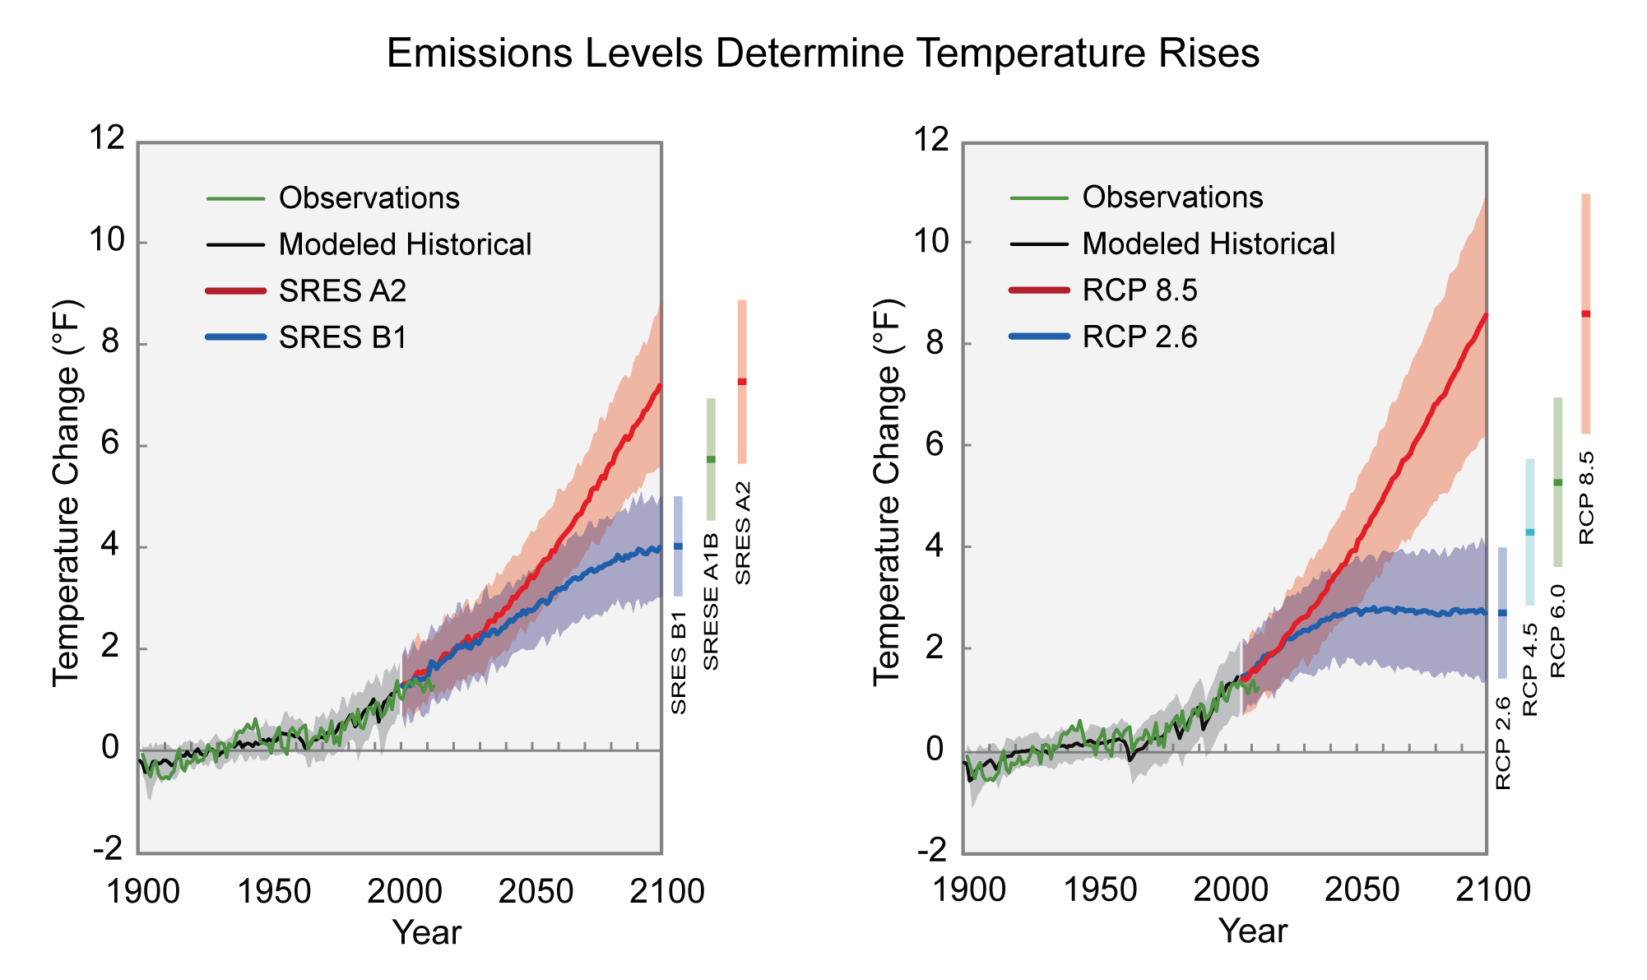
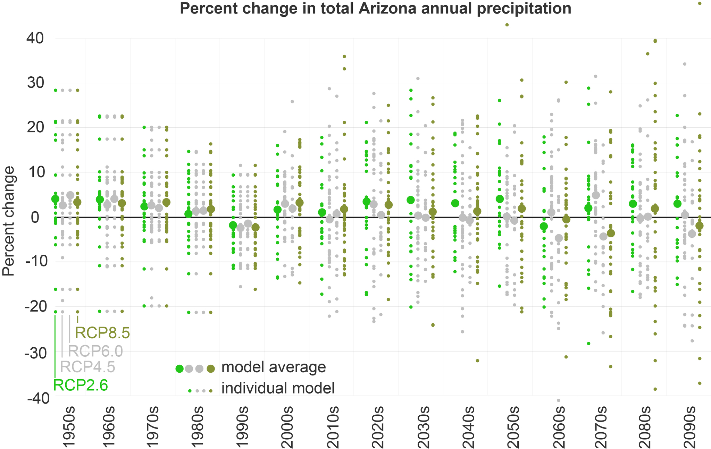
Planning for Climate Change
Climate change adds a new dimension to community planning efforts
Climate and environment might be quite different the next time a general plan (or sector plan) is written
Communities are already experiencing impacts
Most communities do not have a climate scientist on staff (yet)
Notes:
A bit of background on the project that is funding our work with the Quad Cities region
Communities and decision makers regularly plan for their communities’ future using all kinds of data: Economic trends, Demographic trends, Geographic trends (growth), Environmental quality, Hazard trends
And while we built our communities assuming that somethings, like climate and environments, are going to be pretty stable - we can’t count on the climate and environment being consistent anymore
Communities make lack climate information entirely
Or they can access publicly available data, but don’t have anyone to interpret it
Or it’s not at the right scale or in the right format
Or the uncertainties are perceived as a barriers

Slide 4
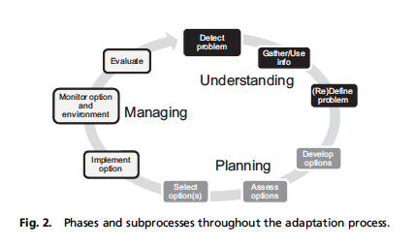
Community Climate Profiles
Climate information and climate change impacts information tailored to community-level decisions.
Notes:
We wanted to try to fill that gap. We have produced a series of reports for communities in Arizona and New Mexico that support community efforts by providing some of the key information that may otherwise be inaccessible.

Slide 5
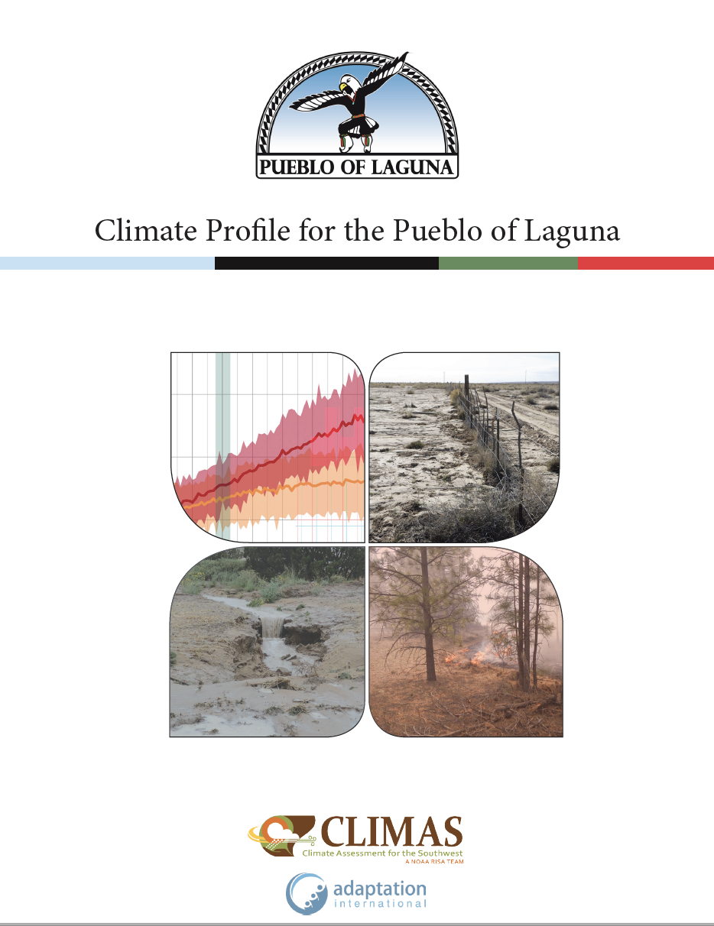
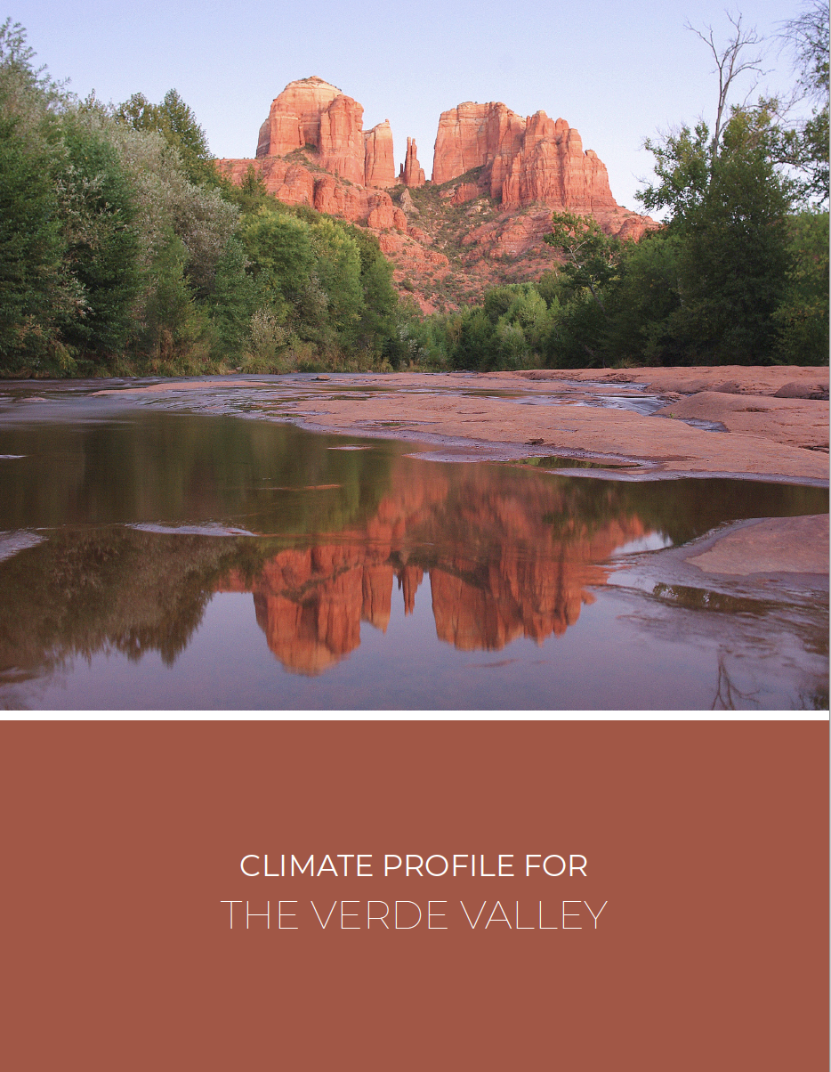
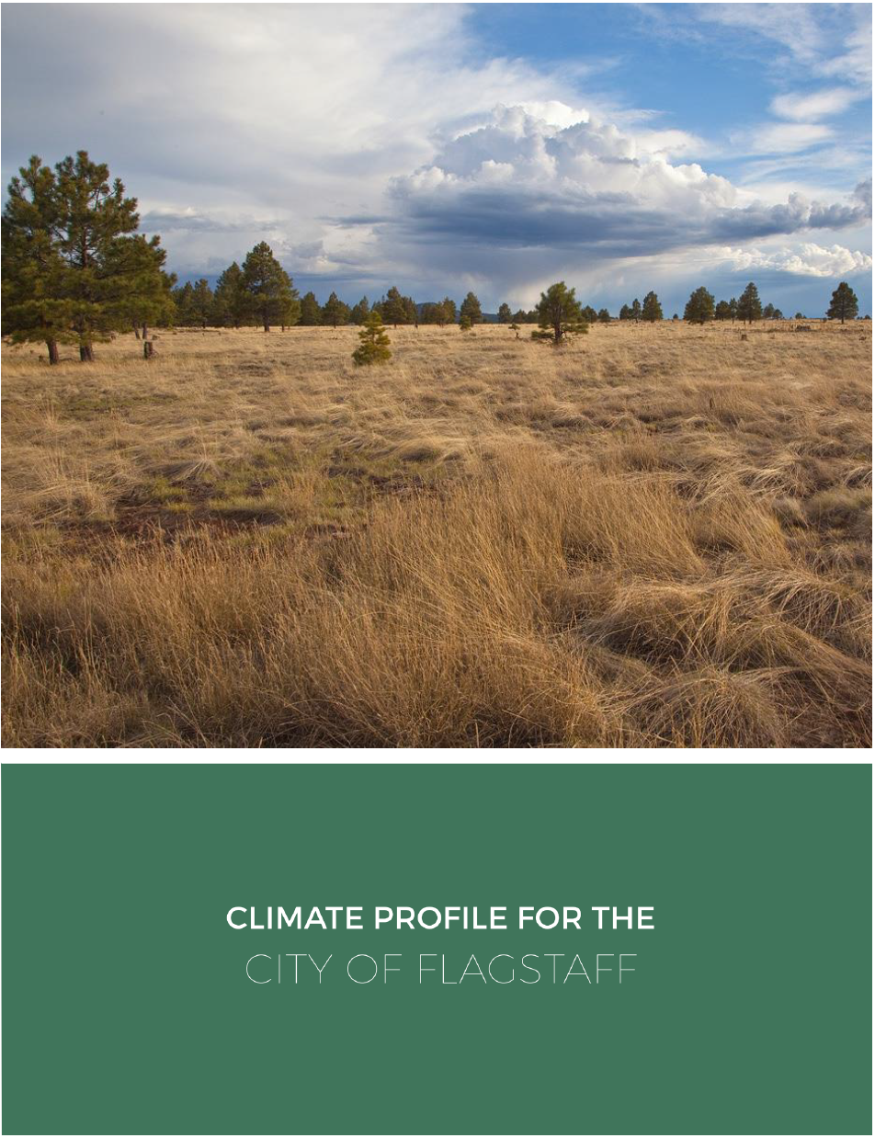
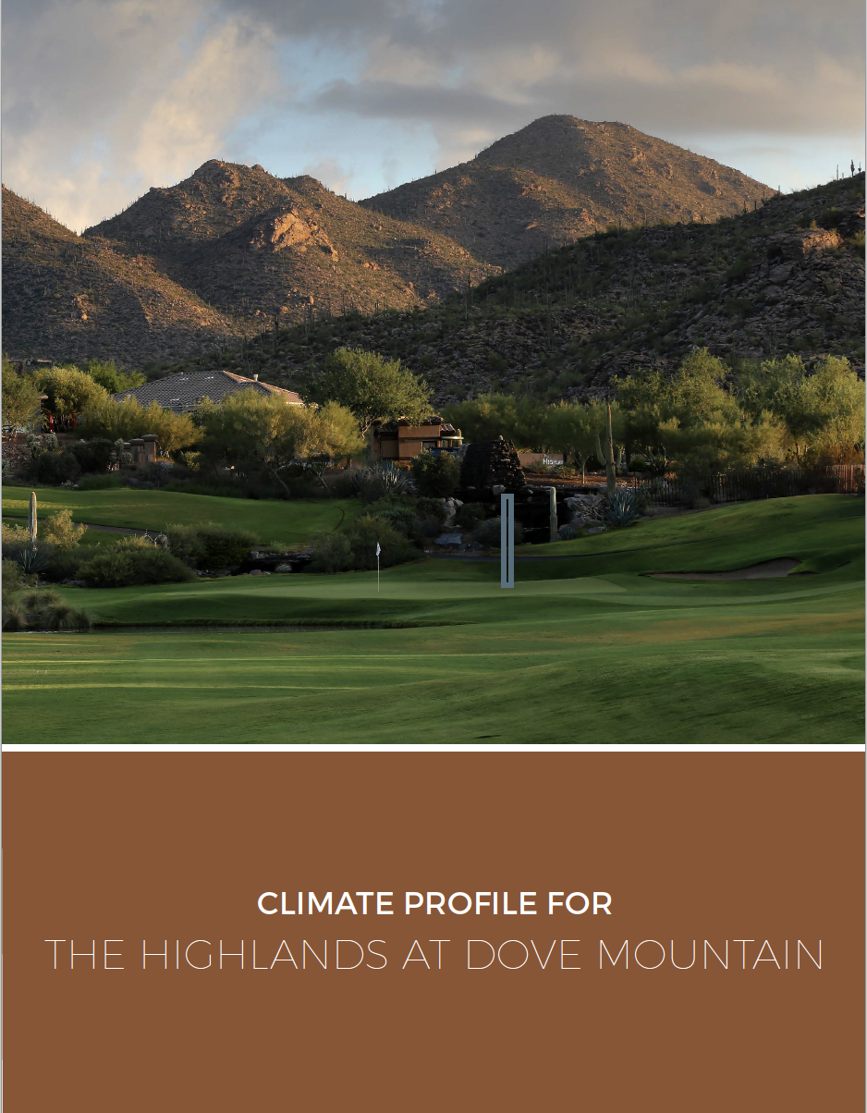
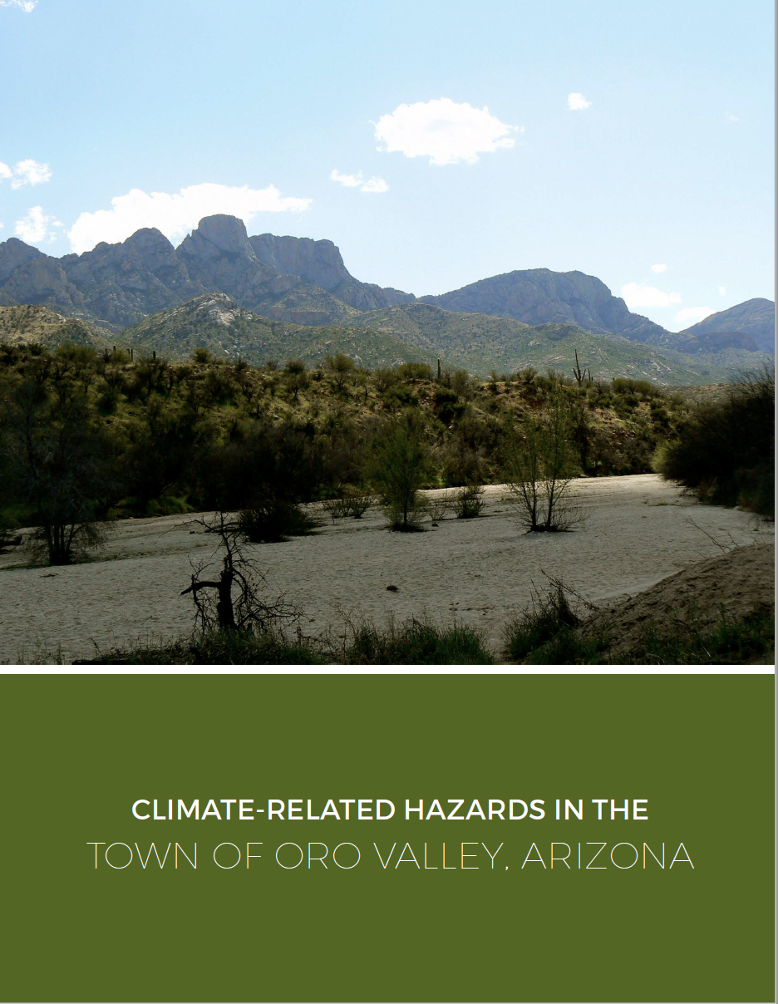
Community Climate Profiles
Notes:
Some of the communities we’ve worked with since this project was funded in 2017.
Quad Cities will be the last of the series unless we are able to identify new funding and additionally personnel specifically for this work.

Slide 6
Profile Contents
Summary of instrumental temperature and precipitation data from 1895
Current climate trends: warming trends in the last 30 years.
Projections of climate change at a regional (or slightly sub-regional) scale.
Summary of general, but likely, regional climate impacts
Examples of possible adaptation strategies
Explanations of key climate phenomenon
Notes:
Important: wherever possible we include explanations of how the analyses were conducted, what types of data were used and why (such as PRISM), and the strengths and weaknesses of downscaled climate models (i.e. why it’s not scientifically sound to downscale to a specific municipal scale). We want to be transparent in our presentation of data so that we’re not black-boxing anything, perpetuating the problem of climate science being perceived as not credible, salient, or legitimate to those unfamiliar with it.

Slide 7
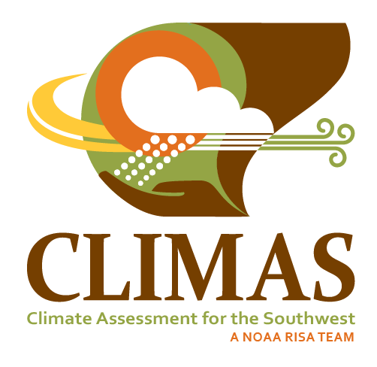
Scope and Scale
Community Climate Profiles are intended as input into a community adaptation planning process
Our goal is to work with communities who have already committed to adaptation planning in order to be a resource
We have limits on what we can provide
Scientific limitations
We rely on available (vetted) data and tailor how we scale and present it to be as applicable as possible.
Engagement limitations
Engagement must be driven by the community to be most effective
Ideas and options – not recommendations or requirements
We cannot tell communities what to do – but we can provide some examples to start conversation

Slide 8
Study Area
Notes:
We decided on the Prescott AMA because it encompasses the main Quad Cities communities and is an already in-use “decision scale.”

Slide 9
Average Temperatures and Precipitation

Slide 10
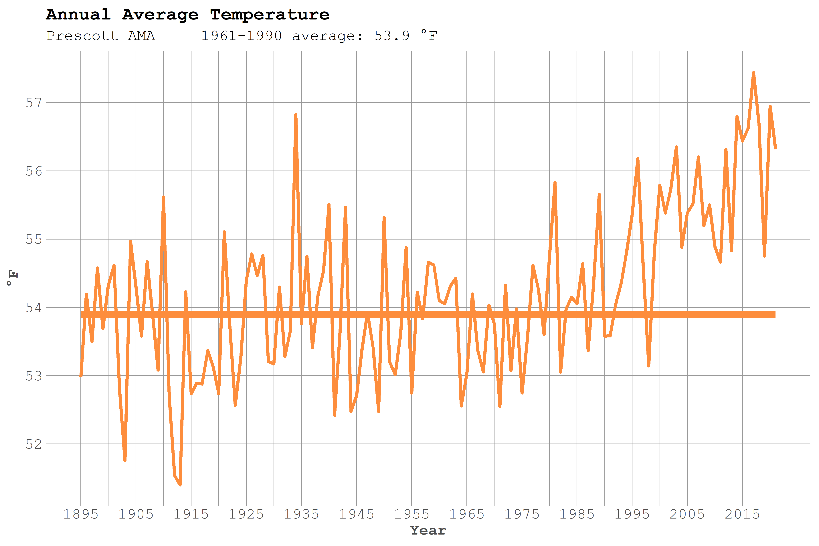
Temperatures Instrumental Record
Notes:
We used the Parameter elevation Regression on Independent Slopes Model (PRISM)2 dataset, which begins in 1895 with the first consistently recorded instrumental climate records. Climatologists refer to the period from 1895 to the present as the “instrumental record” period. PRISM uses regional weather station observations to estimate climate variables for 2.5-mile (4-km) areas in a continuous grid across the United States (Daly et al. 2002).
The stations used in PRISM mainly come from the National Weather Service Cooperative Observer Program of the National Oceanic and Atmospheric Administration, which have the longest
continuous record of weather data. Data from other weather stations are included if they have at least 20 years of data.
PRISM accounts for variations in weather and climate due to complex terrain, rain shadows, elevation, and aspect – all of which affect weather and climate across the Quad Cities region.
Long term average temp (average of high and low of each day) is a little under 55 degrees.
And we see the expected variability for most of this record – some warm years, some cooler years – all of that is pretty normal.
Since 2000 every year has been above the long term average.

Slide 11
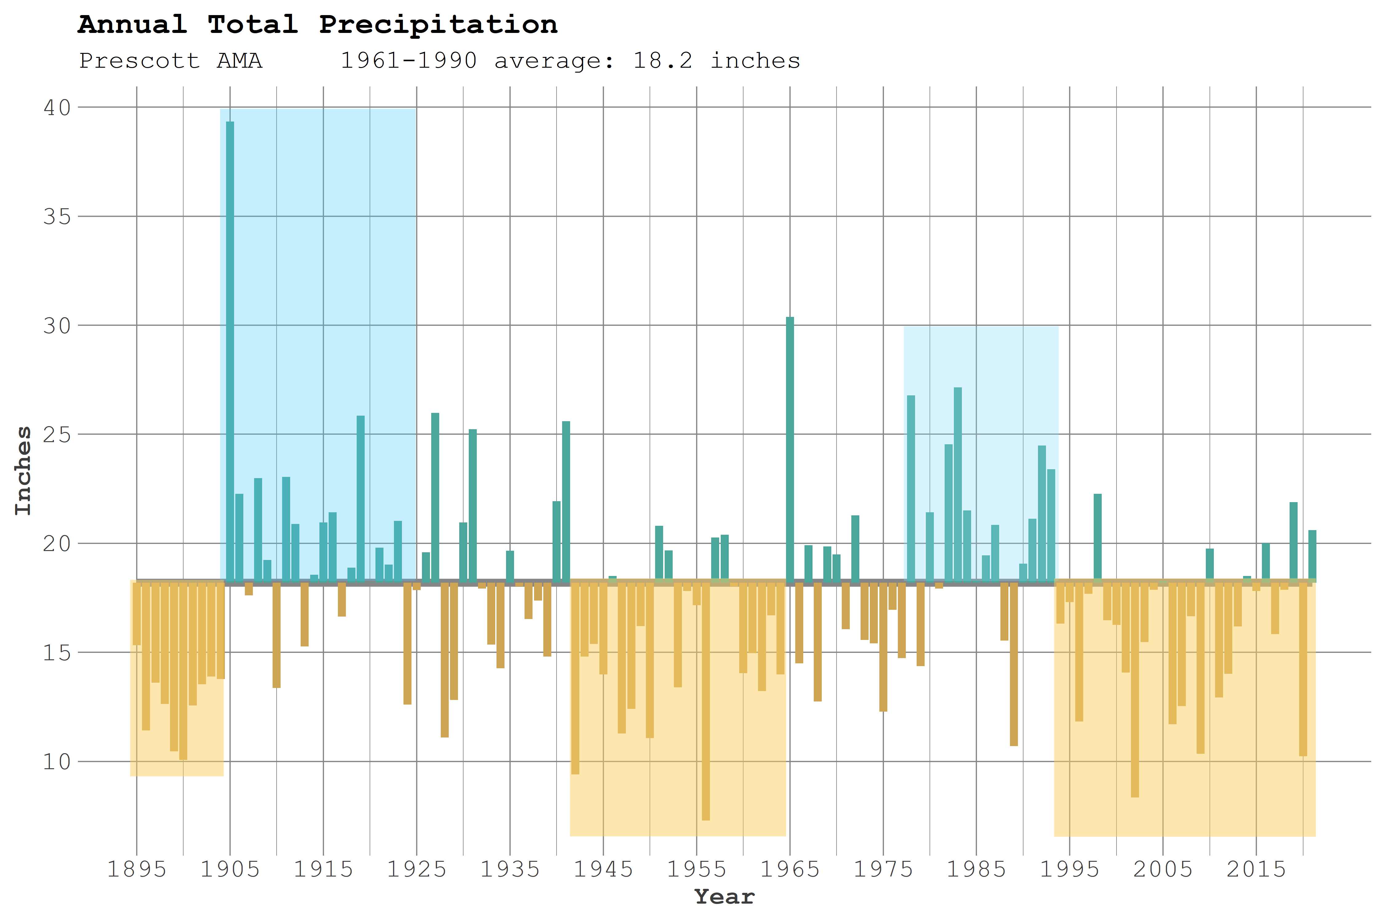
Precipitation Instrumental Record
Notes:
Even more so with precipitation, the natural variability in this region is the “norm” - some wet years, some dry years.
Reference period average – about 18 inches per year. High – 1905 – almost 40 inches of rain. Low – 1956 – about 8 inches.
The Quad Cities region has experienced two periods of generally above-average precipitation (pluvials). The most distinct pluvials occurred from 1905 through the mid-1920s, and again in the late 1970s through the mid-1990s. Multi-year drought periods (multiple years with below-average precipitation), occurred in the late 1800s to early 1900s, 1940s-early 1960s, and 2000s. These drought periods were felt across a broad swath of the Southwest.

Slide 12
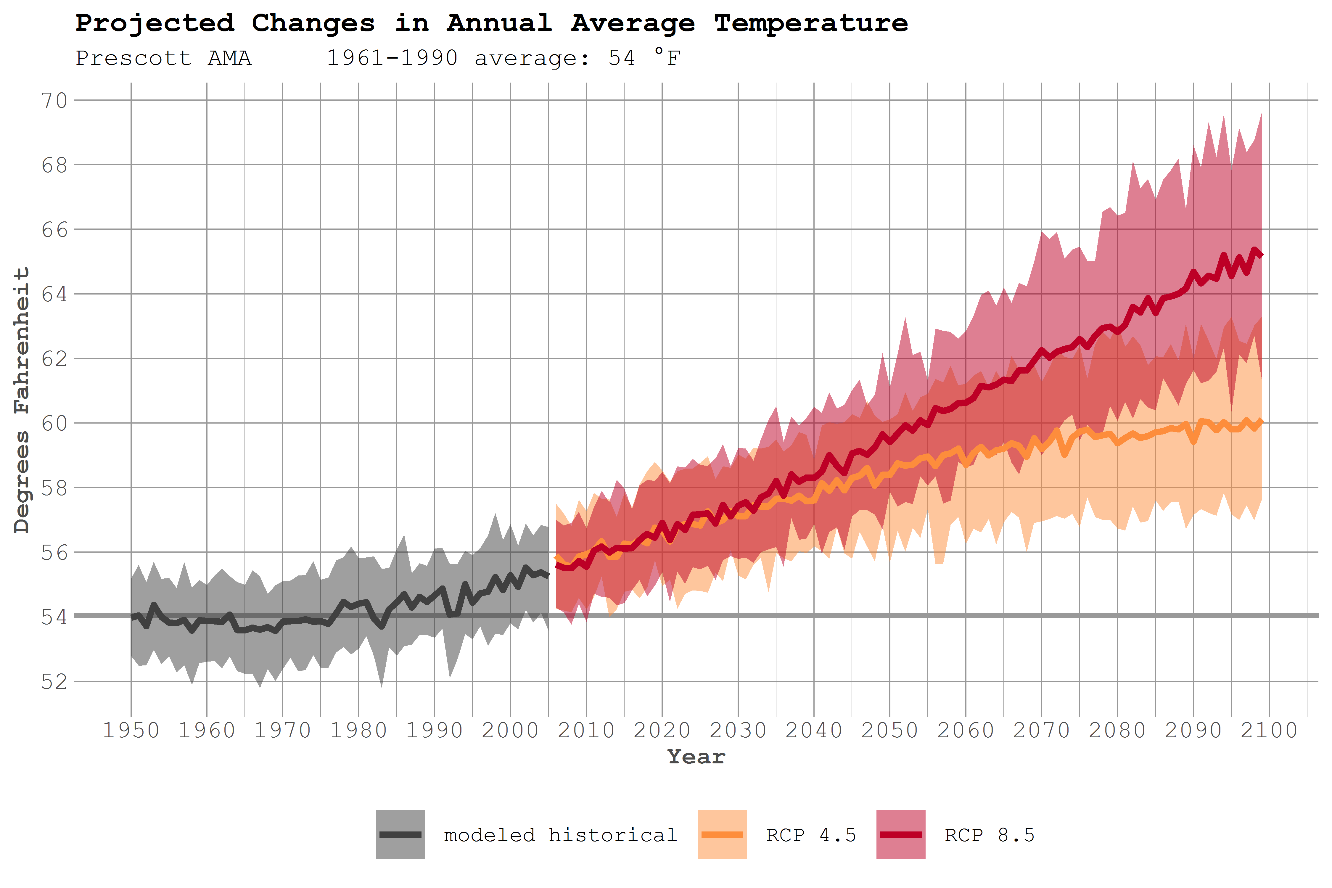
Projected Annual Average Temperature
Notes:
Downscaled model projections for the Prescott AMA region show a range of possible future temperature increases, depending on the climate scenario. Explain RCPs and scenarios.
The average annual temperature for the reference period 1961 – 1990 was 54 degrees. That is projected to climb 4 – 5 degrees by 2050 for RCP 4.5 and 8.5, respectively. By the end of the century, annual average temperatures could be between 6° F higher than the 1961-1990 average for RCP 4.5 (orange line and shading) to over 11° F higher for RCP 8.5 (red line and shading) by the year 2100.
Albuquerque, NM average – about 59 degrees. Annual average temperature in Tucson, AZ now is approximately 68° F.

Slide 13
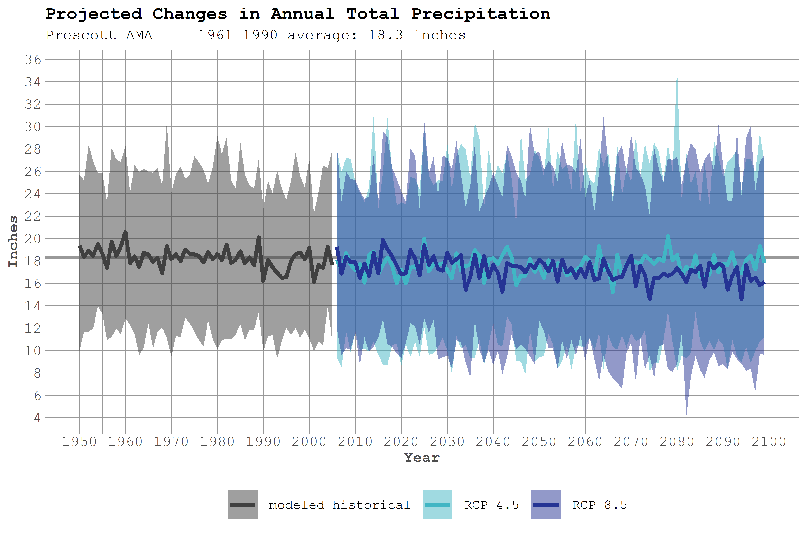
Projected Annual Average Precipitation
Notes:
While the projections for temperature show possible increases in both scenarios, the projections show little-to-no change in annual total precipitation for the Prescott AMA. The light blue line, representing the lower scenario, shows no change in the amount of annual precipitation by the end of the century. The dark blue line, representing the higher scenario, shows the potential for a slight decrease (about 2 inches inches) in annual total precipitation by the end of the century. However, given the uncertainty of these projections (discussed in the paragraph below), many climate scientists recommend assuming that annual total precipitation in the region will remain relatively consistent, with year-to-year variation as we see now.
It is important to note that modeling precipitation for this region has proven very difficult, due to the multiple phenomena that influence this region, including the El Niño Southern Oscillation (ENSO), the Pacific Decadal Oscillation (PDO), the North American Monsoon (NAM), and atmospheric rivers (narrow corridors of concentrated moisture in the atmosphere that lead to extreme precipitation events in the western U.S.). Projections of annual average precipitation in the Southwest region are less certain than projections of future precipitation in other parts of the country (Gershunov et al. 2013). However, even if there is no change in total precipitation, the Prescott AMA could become much drier as projected warmer temperatures will mean more evaporation of surface water and more transpiration (use of water by plants), which will further dry the soil, with the potential changes in soil moisture particularly large in the winter and spring. Additionally, higher temperatures in the winter will result in more precipitation falling as rain than snow, and higher spring temperatures will mean earlier snowmelt, all of which will likely lead to reduced snowpack and streamflow.
The authors of the 2013 Assessment of Climate Change in the Southwest United States expressed only medium-low confidence in projections related to precipitation changes in the region (Overpeck et al. 2013).

Slide 14
Climate Extremes

Slide 15
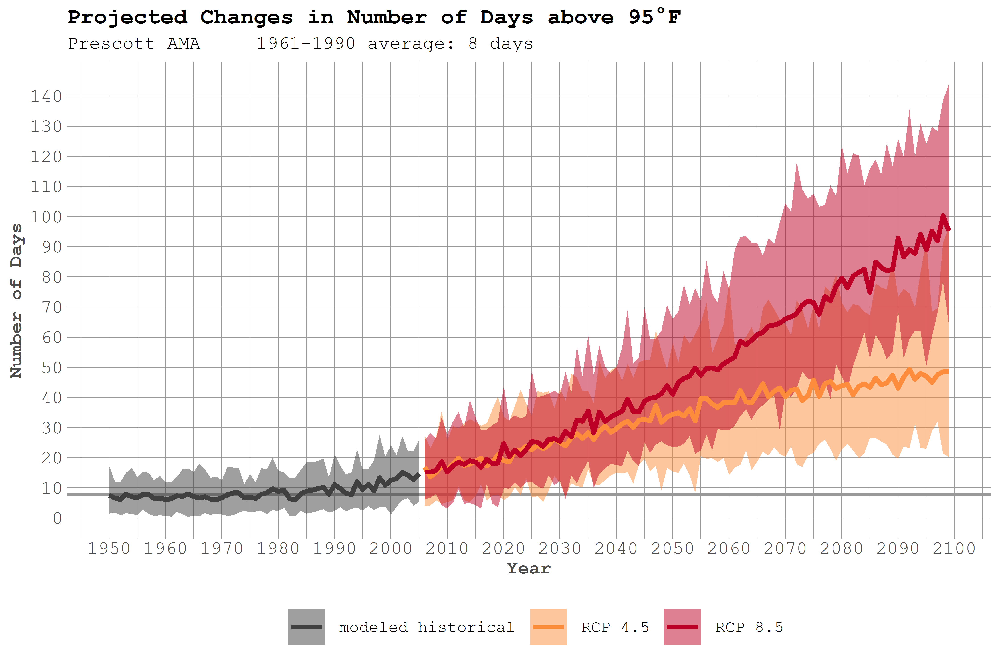
Days Above 95º
Notes:
The average number of days above 95° F in the Prescott AMA is 8 days per year (between 1961 and 1990). Recently, the area has seen about 20 days/year over 95. The projected change in the number of days above 95° F by 2100 range from: 35 – 40 days by 2050 and 50 days per year (lower scenario) to as many as 95 days per year (higher scenario) by the end of the century.

Slide 16
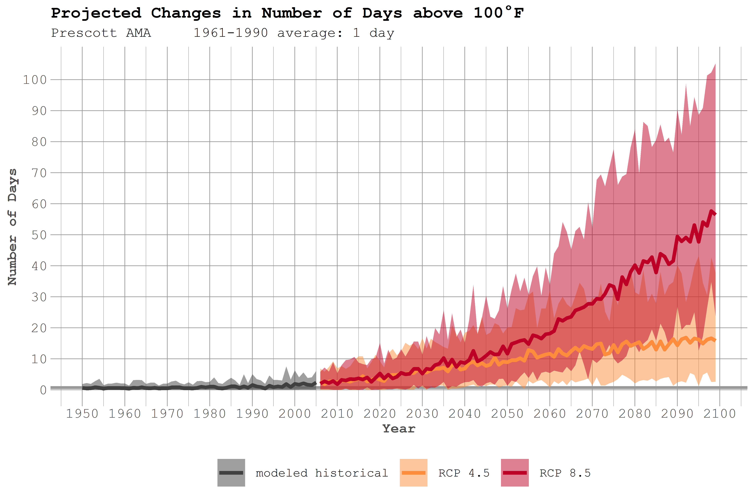
Days Above 100º
Notes:
The average number of days above 100° F in the Prescott AMA is 1 days per year (between 1961 and 1990). Recently, the area has seen about 5 days/year over 100. The projected change in the number of days above 100° F range from: 10 – 12 days by 2050 and 15 days per year (lower scenario) to as many as 55 days per year (higher scenario) by the end of the century.

Slide 17
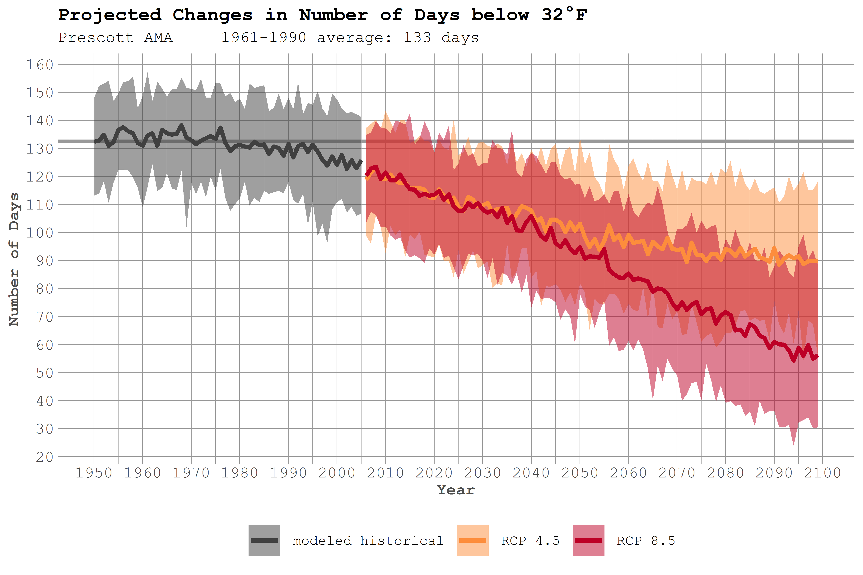
Days Below 32º
Notes:
On average, the Prescott AMA has experienced 133 days per year in which the minimum temperature is 32° F or colder. Projections for the region indicate that the number of days that fall below the freezing point could decrease to between 95 and 100 days by 2050 and to 90 days/year (RCP 4.5) and as few as 55 days (8.5) by the end of the century.

Slide 18
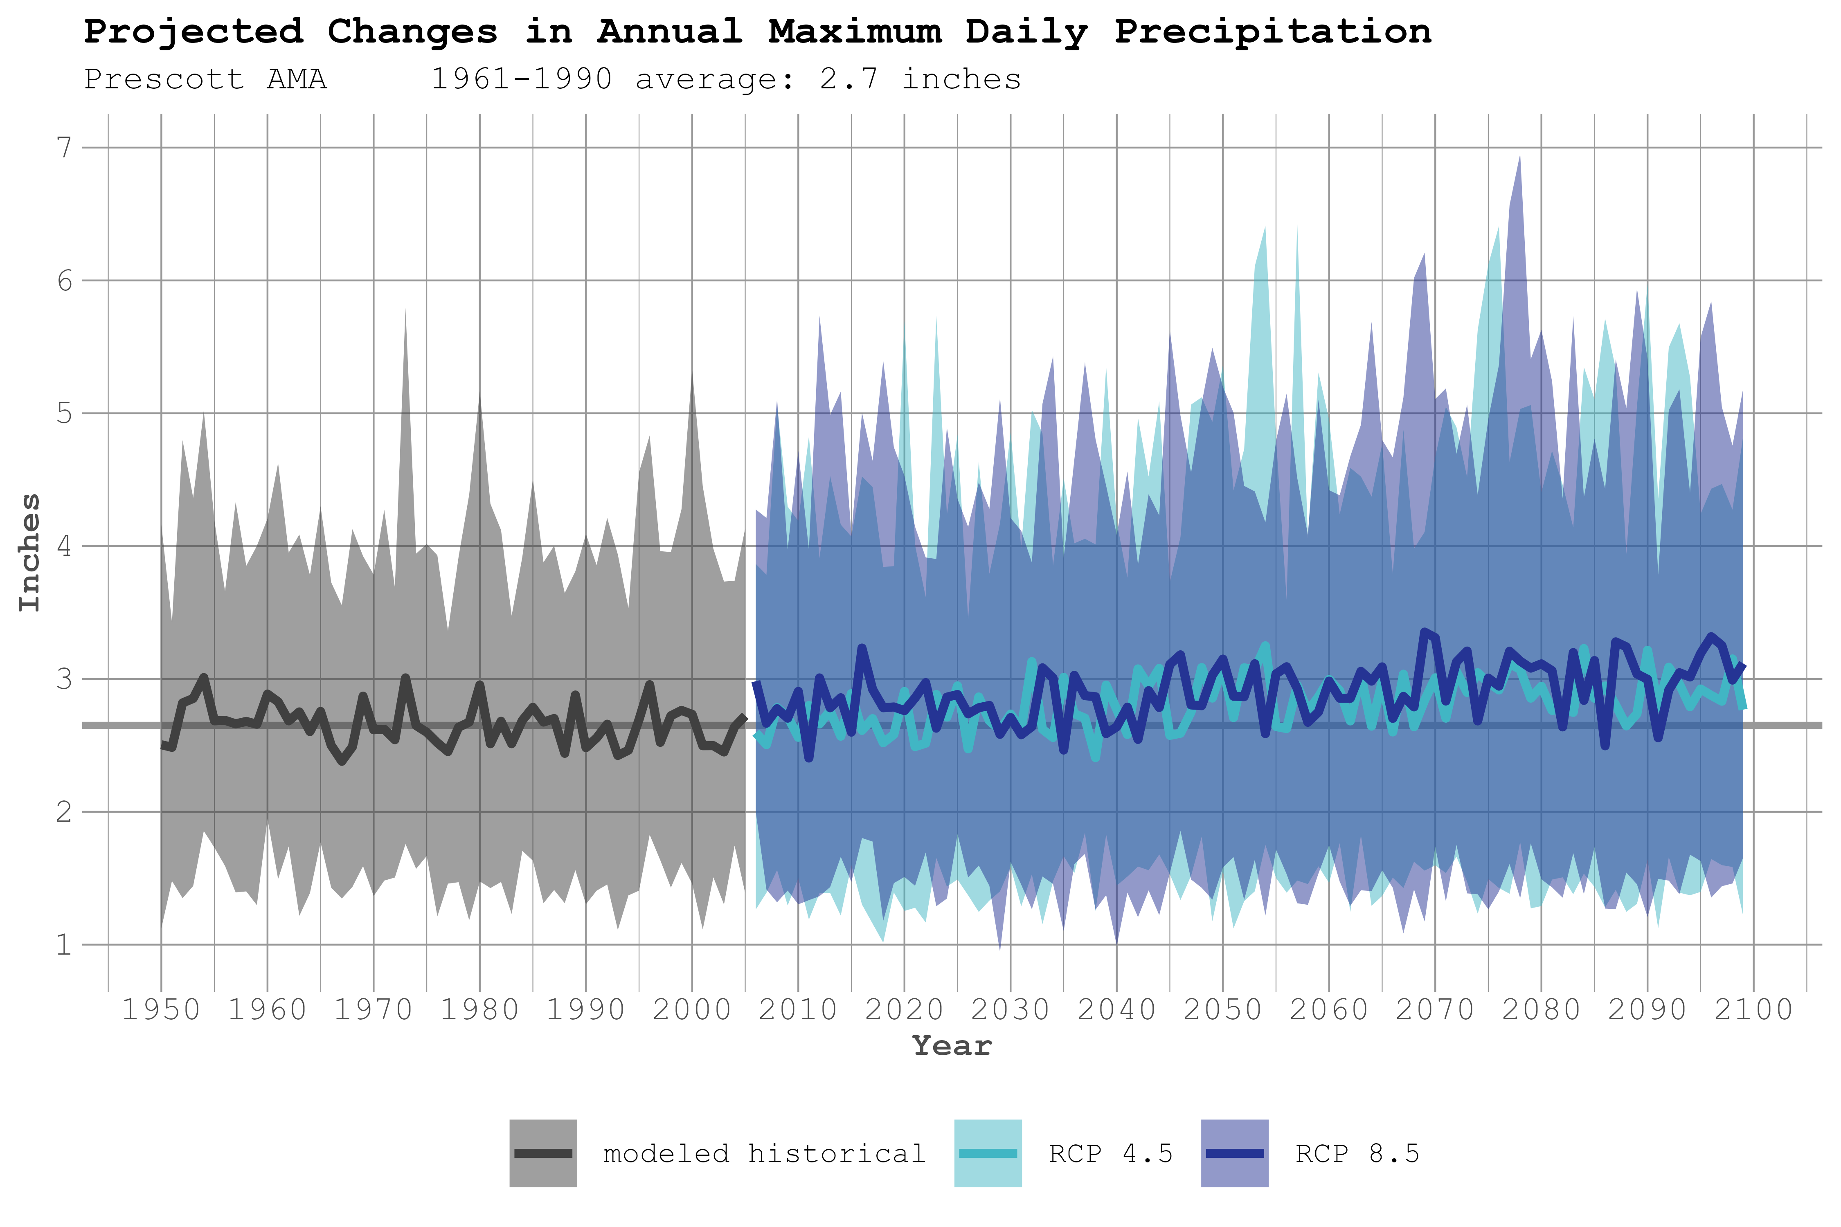
Annual Daily Maximum Precipitation
Notes:
Annual daily maximum precipitation is a measure of the largest, single day precipitation event that falls each year.
Between 1961 and 1990, the average of daily maximum precipitation (average of all the daily maximums) was 2.7 inches. In this figure we do not see much projected change according to the model average lines – they both show the possibility of the average daily maximum precipitation reaching about 3 inches. However, when we look at the shaded area, which reflects the range of the data from each of the 32 models used in this analysis, we see that the shaded area (which is the spread, or cumulative data from all the models) is larger above the average line. This indicates that there is a greater likelihood of larger storms with higher daily maximum precipitation in the future.

Slide 19
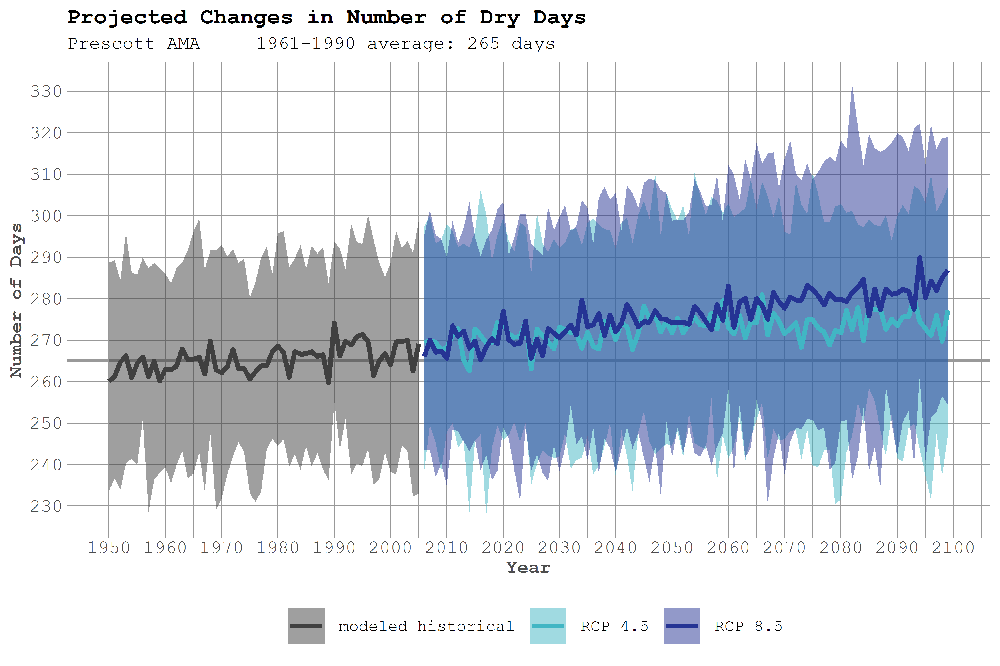
Dry Days
Notes:
Dry days refer to days with less than 0.01” of rain.
In the reference period of 1961 – 1990, the Prescott AMA region averaged 265 dry days/year. More recently, the area has had about 270 dry days. By 2050, the area could see an additional 5 dry days/year (about 275 total). And by the end of the century, the area may have between 275 (lower emissions scenario) and 285 (higher emissions scenario) dry days.
SO – about the same annual precip, but likely to be in larger storms (daily max precip seems to be leaning heavier), and fewer dry days. Bigger, but less frequent precip events.

Slide 20
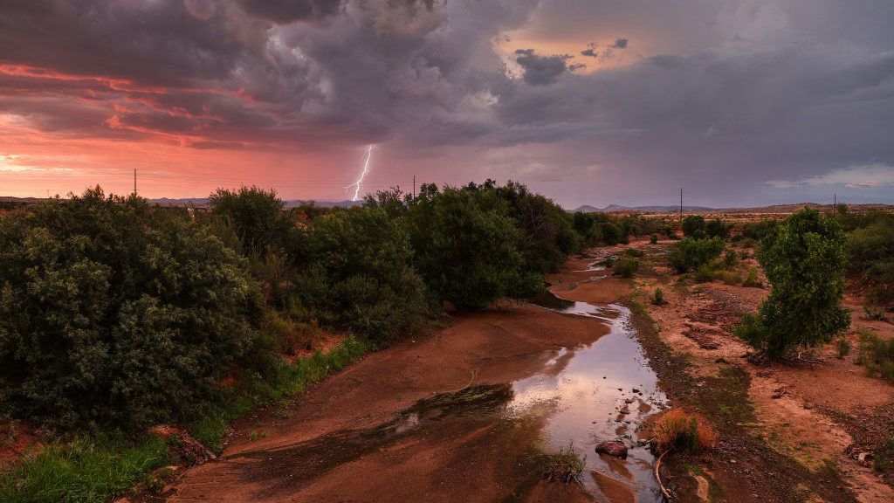
Changing Character of Precipitation
Warming temperatures allow the atmosphere to hold more moisture
More dry days
About the same annual average precipitation
Fewer storms – but more extreme events when they do arrive
Warming temperatures will bring rain instead of snow – and snowline will retreat to higher elevations
Warming temperatures mean more evaporation of surface water and more transpiration by plants, leading to drier soils.

Slide 21
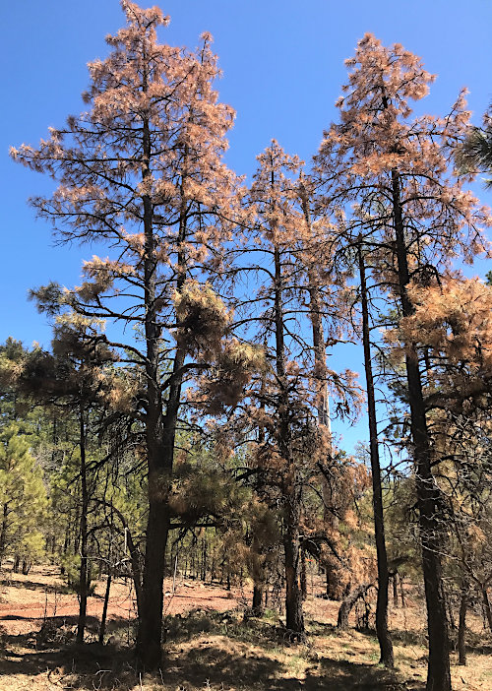
Forest Health Impacts
Direct stress from heat and lack of moisture reduced tree growth and increases tree mortality
Insect outbreaks increase with warmer temperatures; drought-stressed forests are more vulnerable to insects

Slide 22
Wildfires
Notes:
Wildfires were already burning more acres (yellow), and climate change is adding on to that trend.
Past management policies left a lot of fuels built up in our forests . . .
Insect outbreaks are contributing
Human settlement – and human starts – are contributing
The cumulative forest area burned by wildfires has greatly increased between 1984 and 2015, with analyses estimating that the area burned by wildfire across the western United States over that period was twice what would have burned had climate change not occurred. Source: Figure 25.4 from Gonzalez et al. (2018); adapted from Abatzoglou and Williams (2016).

Slide 23
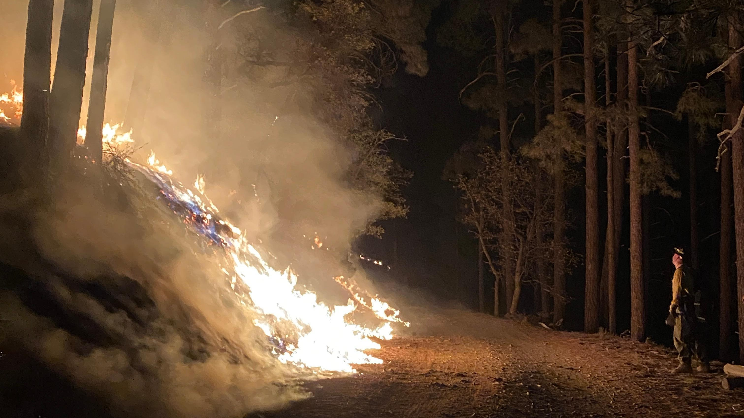
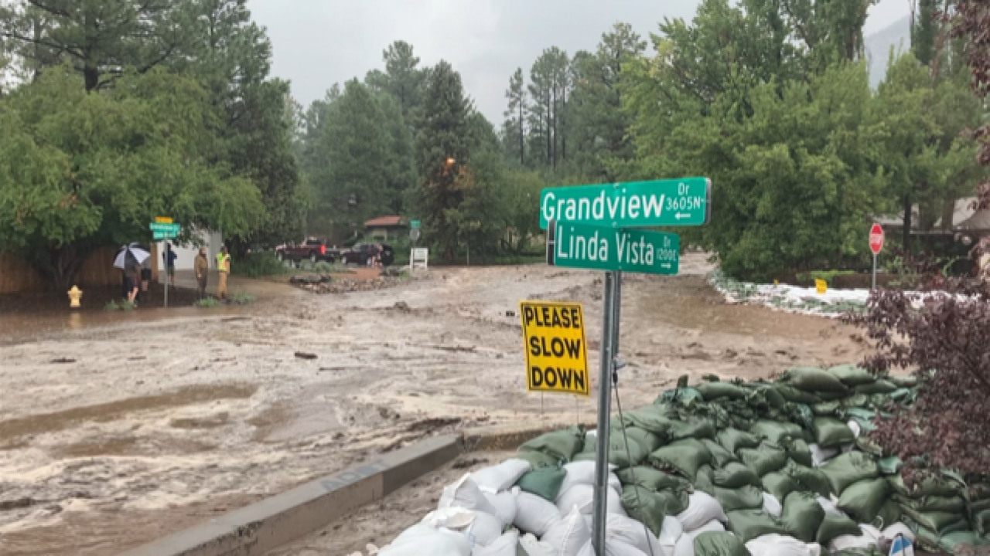
WUI Risk
Number of homes in the WUI is increasing every year (nationwide)
Combination of larger forest fires and more extreme precipitation leads to more post-fire flooding and debris flows.

Slide 24
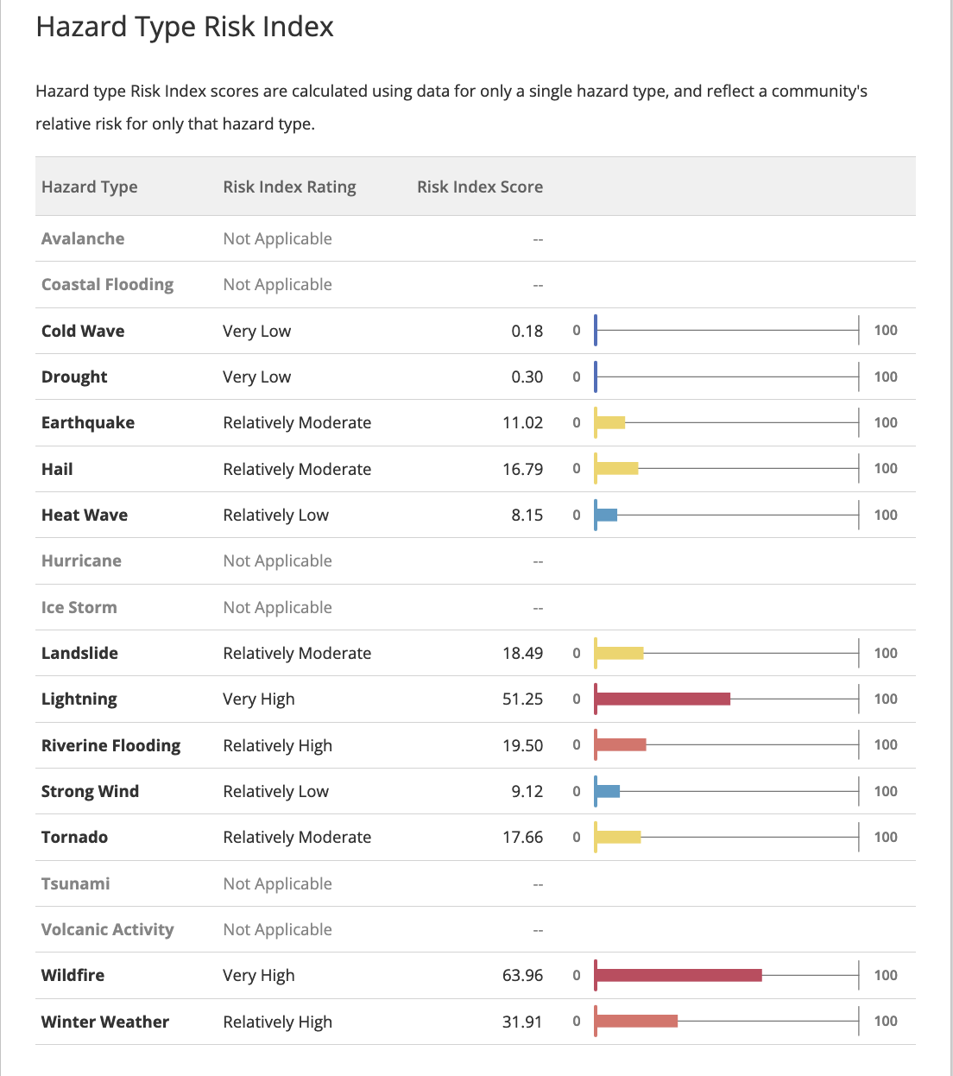
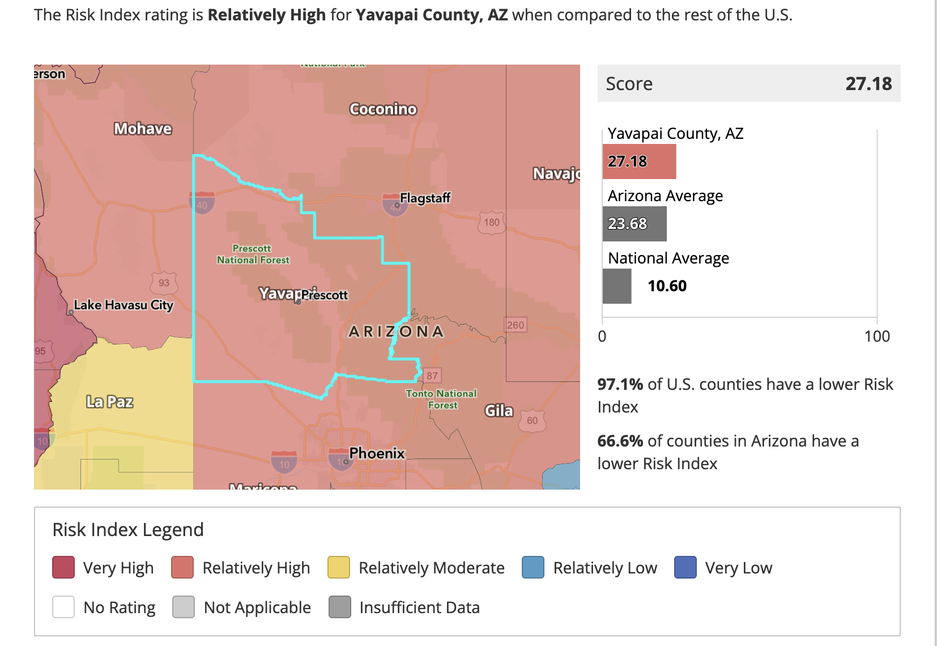
https://hazards.fema.gov/nri/
Notes:
FEMA’s National Risk Index scores Yavapai County as “relatively high” when compared to the rest of the US (also higher than the rest of Arizona)
Wildfire is the highest risk, with lightning not too far behind.

Slide 25
Adaptation Resources
Remove all flammable materials from under decks and porches
Attend evacuation/preparedness trainings
Replace combustible mulch material with stone/gravel
Debris removal and maintenance of commonly owned areas

Slide 26
Adaptation Resources
Planning the Wildland-Urban Interface
Balance affordable housing needs and wildfire risk if development is proposed in WUI areas and incentivize developments to occur in lower-risk areas, particularly within existing communities
Review transportation plans and the accessibility of existing neighborhoods and developments to allow for quick and efficient evacuation.
Subdivision Design and Flood Hazard Areas
Protect open space to minimize the increase of impervious surfaces and flood risk through the development of natural areas.
Avoid new development in flood-prone areas and consider future conditions of the floodplain, including both development impacts and climate change.
American Planning Association

Slide 27
Adaptation Resources
USDA Forest Service Climate Adaptation Plan
1d. Prepare for more post-fire landscapes
2b: Help watersheds adapt to changing conditions, drought, and flooding
2c: Help ecosystems adapt to intensifying disturbances and extreme events
5d: Help communities become fire-adapted as they prepare for climate change

Slide 28
Thank you!

