Slide 1
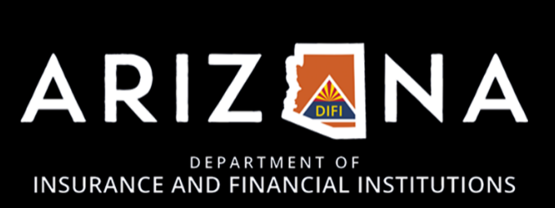
Homeowners Insurance in Arizona

Slide 2
DIFI’s Regulatory Authority over Homeowners Insurance

Slide 3
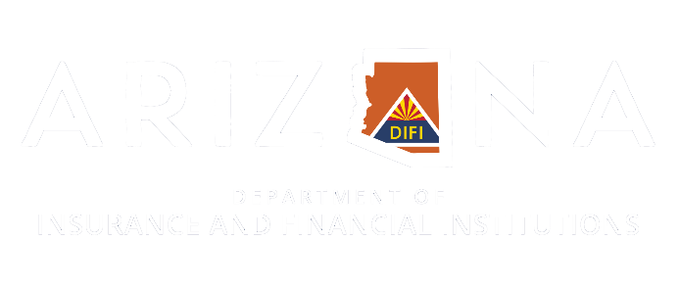
Rate Filing
In Arizona, insurer rates and rate changes are “Use and File”
Rate changes may be instituted immediately; insurers must file within 30 days
Rates must not be:
Excessive - rates must be competitive
Inadequate - rates must be sufficient to ensure solvency
Unfairly discriminatory - like risks must be rated similarly
The homeowners insurance market is currently considered competitive and rates actuarially supported
DIFI has limited authority to disapprove rate filings

Slide 4
Rate-setting Criteria for Insurers
When setting rates an insurer must consider:
past and prospective loss and expense experience
catastrophe hazards
profit margin and contingencies
investment income
trends within and outside the state
dividends or savings to be returned to policyholders
other judgment factors
Rates may be modified for individual risks in accordance with reasonable standards for measuring variations in hazards (fire models) or expenses
Notes:
Per 20-384 B/C. Can’t use other states’ loss history that doesn’t happen in AZ. DIFI frowns on OOS data unless it’s relevant. Insurers are trying to stay competitive without going broke.

Slide 5
Homeowners Insurance Trends Nationally and in Arizona

Slide 6
Factors Influencing Rates and Availability
Inflation
increases the cost to replace insured real and personal property; congested supply chains
Construction Costs
the cost to rebuild a home after a loss
Home Values
higher value homes require higher coverage limits
Fire Risk (other catastrophes)
adequacy of community to respond to fires; resiliency of the structure to fire
Underwriting Restrictions
Coverage Type, Limits, and Deductibles

Slide 7
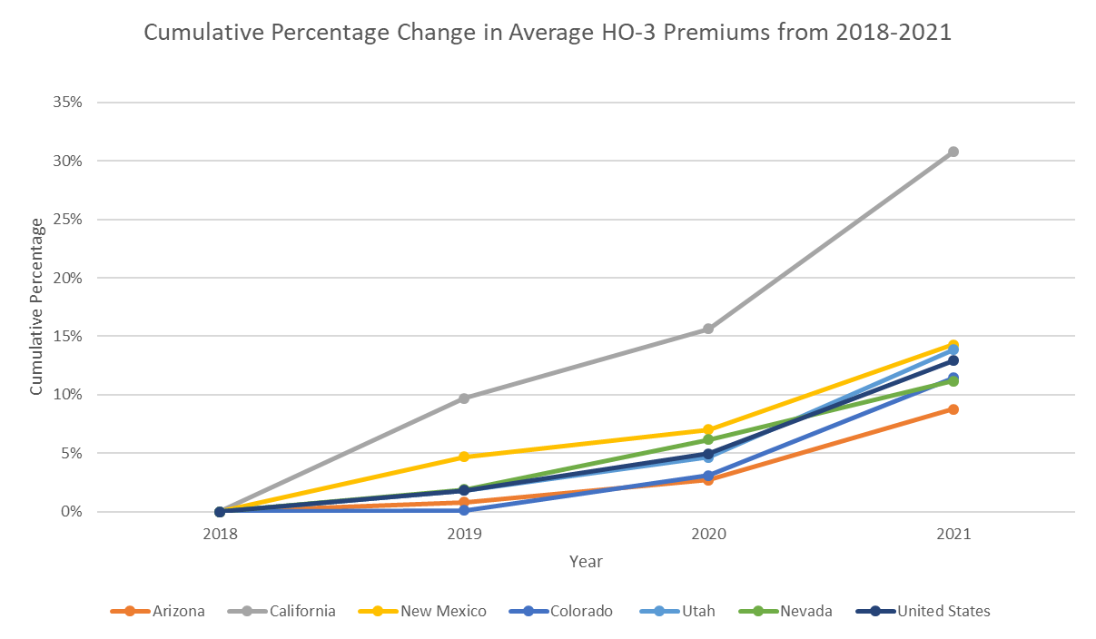
Cumulative Average HO-3 Rate Changes
From 2018 to 2021, the average HO-3 rate increased cumulatively by approximately 9% in Arizona, compared to 13% nationally.
The average HO-3 premium does not account for geographic variations in rates within Arizona.
It is an imperfect measure of the relative price of insurance.
Source: NAIC, raw data – unadjusted
Notes:
Imperfect because of variances in peril, real estate values, economic conditions

Slide 8
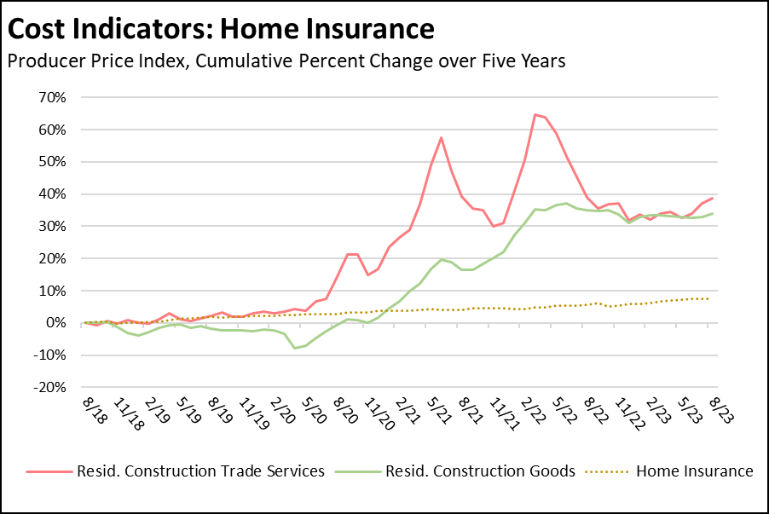
Construction Costs Increasing Nationally
Nationally, construction costs have increased over 30% within the last 5 years, adjusted for inflation
Average reconstruction costs for residential structures in Arizona increased 6% from September 2022 to September 2023 (Verisk)
Construction costs vary based on:
the type of residence
building materials
local climate
building codes/regulations
Source: APCIA
Notes:
Newer data HO insurance has actually lagged behind construction costs

Slide 9
Insurers Leaving States with High Risk of Catastrophic Disasters
Louisiana: many insurers have withdrawn or gone insolvent within the past three years
Florida: many major insurers have withdrawn, leaving small insurers to cover losses
California: many insurers have closed their books or limited writing of new policies
Source: NBC News
Notes:
Increasingly hearing of homeowners forgoing insurance due to high cost.

Slide 10
Impacts of Wildfire Risk on Arizona Homeowners

Slide 11
Issues Facing Arizona Homeowners
Homeowners insurance premiums are increasing across the state, not just in wildfire-prone areas
the result of a hardening insurance market, i.e. the rates match the risk
large insurers may not increase rates as much as small insurers
Are major insurers assuming risk in rural communities or are they leaving it to smaller insurers?
The primary issue consumers in wildfire-prone areas are experiencing is being non-renewed by their insurer and then struggling to find coverage
complaints from consumers and insurance brokers
Limited evidence of insurers leaving Arizona
one smaller insurer, around $2 million in premiums
Mortgage affordability and availability
Increased flood risk after wildfires
Notes:
Lenders apprehensive
Buyers mortgages + insurance gets you less house

Slide 12
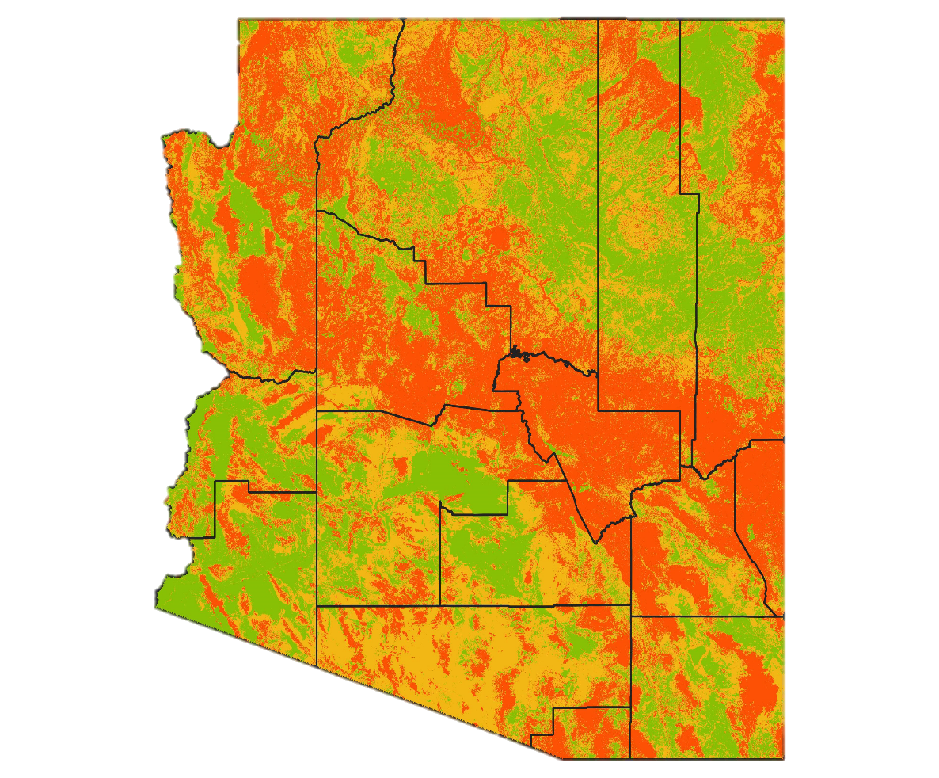
Wildfire Risk in Arizona
As of October 2023, 5% of structures in Arizona are at high to extreme risk from wildfire
Counties with high concentrations of structures in high to extreme risk zones:
Gila - 41%
Navajo - 33%
Greenlee - 27%
Apache - 25%
Coconino - 22%
Legend:
Green - low risk Yellow - moderate risk Red - high to extreme risk
Source: Verisk

Slide 13
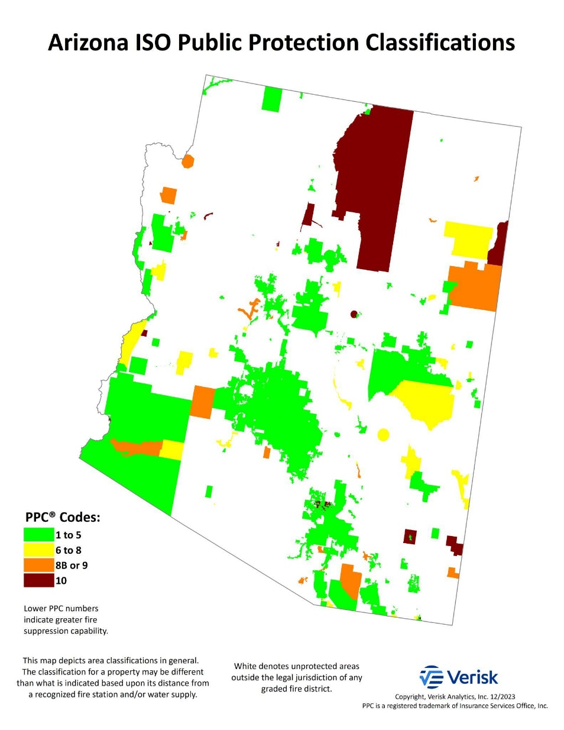
Classifying Fire Protection Capabilities
Insurers commonly use the Insurance Services Organization (ISO) Public Protection Classification (PPC) to determine risk of loss due to fire and price fire insurance
Classes range from 1 (best) to 10 (worst)
Classes are determined by a community’s fire prevention and suppression capabilities, based on:
fire departments/districts
water resources
emergency communications
community risk reduction
Source: Verisk
Notes:
The green areas are a summation of communities that have a PPC of 1 to 5. The boundaries of each graded area are based on the legal fire protection response boundary assigned to a fire department.
So, for example, in cases where a city provides fire protection within city limits. the boundary would be the city limits. In other cases, the boundaries may be based on fire district boundaries etc.
The areas that are red indicate a fire protection response boundary or boundaries, but the fire department isn’t recognized for one reason or another.

Slide 14
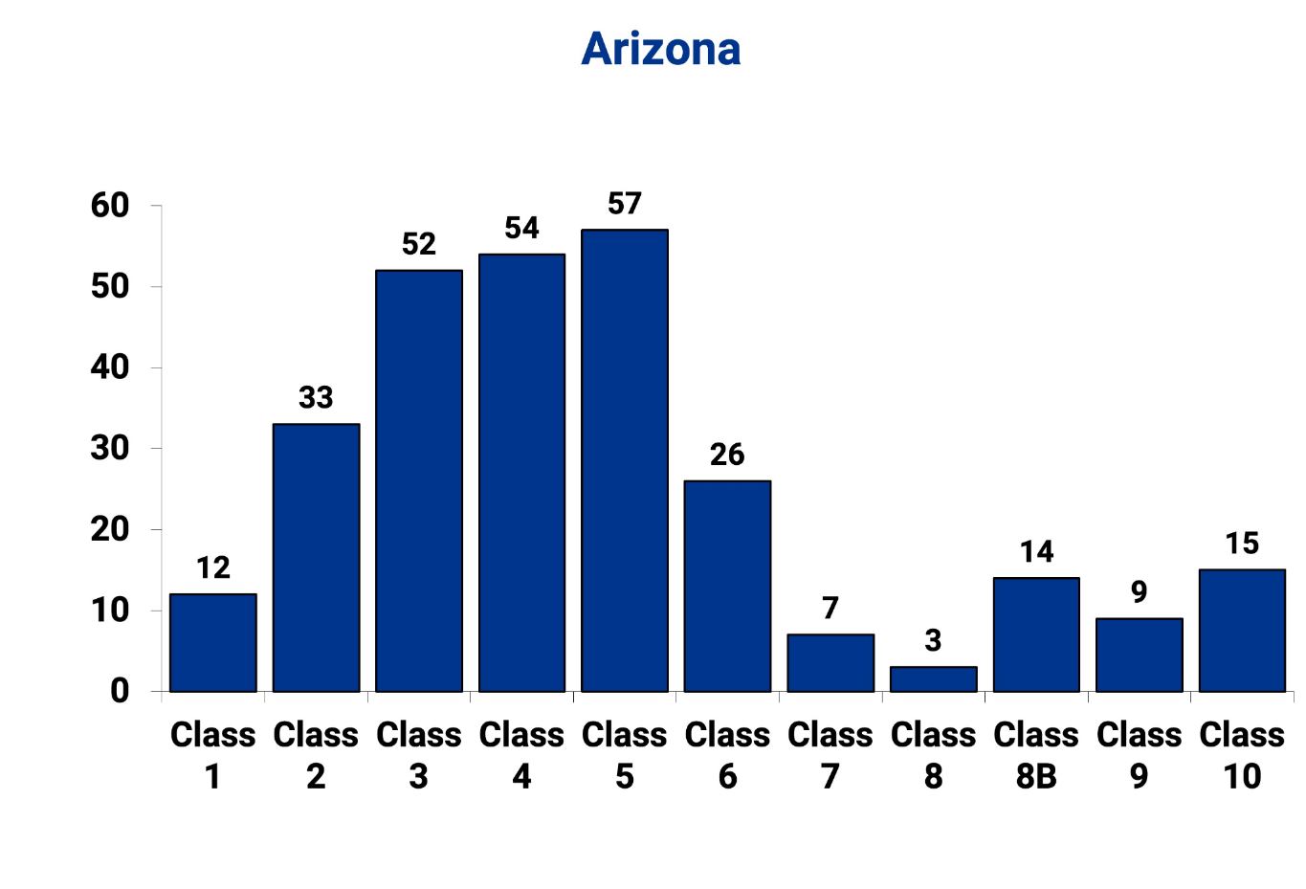
Arizona Communities by PPC Code
38 Arizona communities – those within the jurisdiction of a graded fire department or district – are classified as 8B or worse
An individual property may have a different classification than that of the community in which it is located due to distance from a fire station or water source
Insurers typically will not insure homes graded as Class 10
Source: Verisk

Slide 15
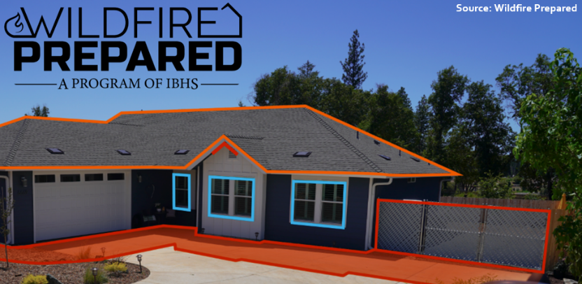
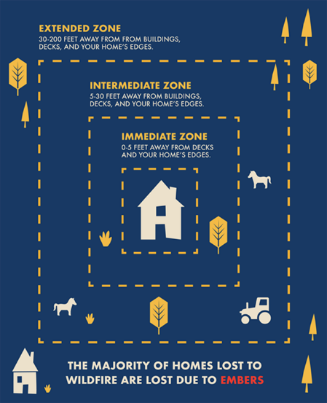
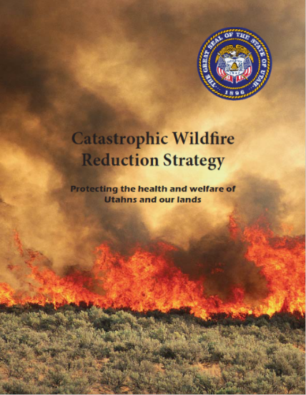
Examples of Mitigation Measures for Homeowners to Reduce Wildfire Risk
Washington: Wildfire Ready Neighbors
California Wildfire Prepared Home -Wildfire Mitigation Program
Utah: Catastrophic Wildfire Reduction Strategy (CatFire)

Slide 16
DIFI Suggestions to Mitigate Risk in Arizona

Slide 17
DIFI’s Actionable Steps
Decrease severity of risk through public outreach and education
Encourage adoption of mitigation initiatives and programs to make communities more resilient to wildfire
Work with insurers to recognize mitigation programs
Provide resources for homeowners to find coverage
Encourage direct consumer-insurer engagement
Notes:
International Wildland-Urban Interface Code
https://www.google.com/url?q=https://codes.iccsafe.org/content/IWUIC2021P1/chapter-5-special-building-construction-regulations&sa=D&source=editors&ust=1704389905315671&usg=AOvVaw3k_TWmwoGk6eX18eBcx6HT

